Slide 1
Four Triangular Areas

Slide 2
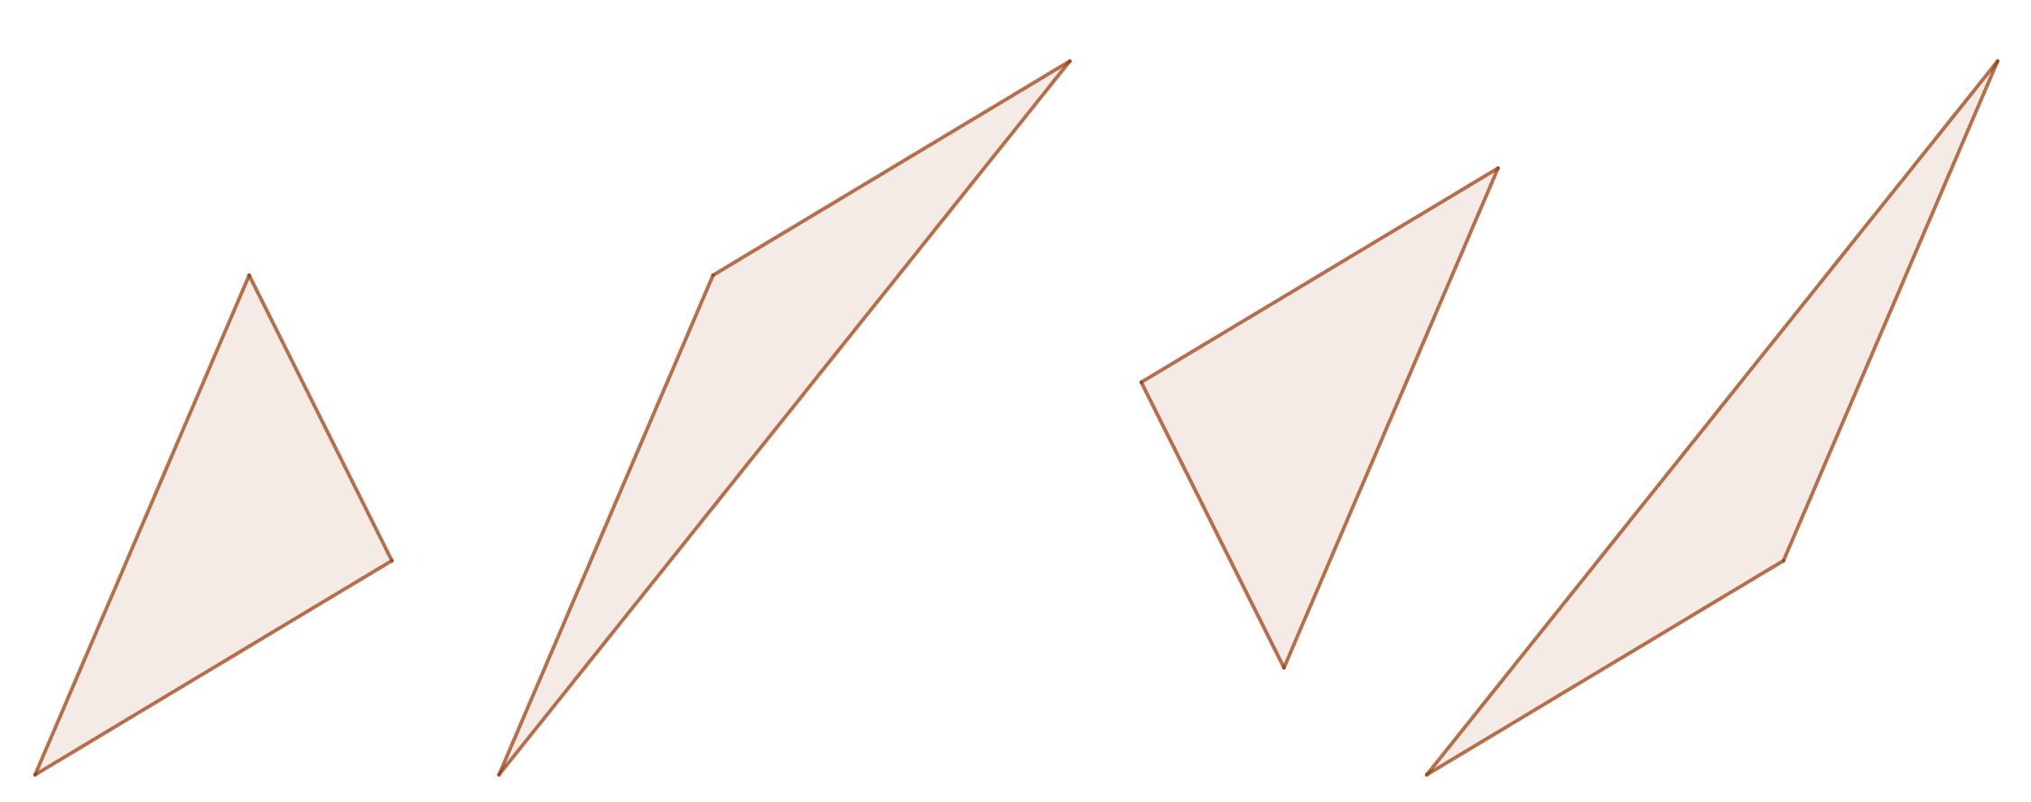












Four Triangular Areas
$$\left(7,13\right)$$
$$\left(10,11\right)$$
$$\left(8,10\right)$$
$$\left(4,9\right)$$
$$\left(2,10\right)$$
$$\left(3,7\right)$$
$$\left(6,5\right)$$
$$\left(7,4\right)$$
$$\left(5,3\right)$$
$$\left(1,2\right)$$
$$\left(−1,3\right)$$
$$\left(2,1\right)$$
A
Calculate the area of each of the four triangles.
The coordinates of each vertex are shown.

Slide 3














Four Triangular Areas
$$\left(7,13\right)$$
$$\left(10,11\right)$$
$$\left(8,10\right)$$
$$\left(4,9\right)$$
$$\left(2,10\right)$$
$$3$$
$$2$$
$$\left(3,7\right)$$
$$4$$
$$13$$
$$\frac{21}{2}$$
$$4$$
$$13$$
$$\frac{85}{2}$$
$$10$$
$$7$$
$$13$$
$$\left(6,5\right)$$
$$13$$
$$7$$
$$\left(7,4\right)$$
$$\frac{21}{2}$$
$$\frac{15}{2}$$
$$3$$
$$\left(5,3\right)$$
$$5$$
$$3$$
$$5$$
$$\left(1,2\right)$$
$$\left(−1,3\right)$$
$$\left(2,1\right)$$

Slide 4
Four Triangular Areas
$$\left(7,13\right)$$
$$\left(10,11\right)$$
$$\left(8,10\right)$$
$$\left(4,9\right)$$
$$\left(2,10\right)$$
$$\left(3,7\right)$$
$$13$$
$$13$$
$$13$$
$$\left(6,5\right)$$
$$13$$
$$\left(7,4\right)$$
$$\left(5,3\right)$$
$$\left(1,2\right)$$
$$\left(−1,3\right)$$
$$\left(2,1\right)$$
Can you explain the result?
Could the triangles be related in some way?
Are any sides parallel?

Slide 5
Four Triangular Areas
$$\left(7,13\right)$$
$$\left(10,11\right)$$
$$\left(8,10\right)$$
$$\left(4,9\right)$$
$$\left(2,10\right)$$
$$\left(3,7\right)$$
$$\left(6,5\right)$$
$$\left(7,4\right)$$
$$\left(5,3\right)$$
$$\left(1,2\right)$$
$$\left(−1,3\right)$$
$$\left(2,1\right)$$
For sides that are parallel and the same length consider giving the vertices the same coordinates by translating to the triangle on the left.

Slide 6









Four Triangular Areas
$$\left(9,12\right)$$
$$\left(9,12\right)$$
$$\left(9,12\right)$$
$$\left(4,9\right)$$
$$\left(4,9\right)$$
$$\left(4,9\right)$$
$$\left(6,5\right)$$
$$\left(6,5\right)$$
$$\left(6,5\right)$$
$$\left(1,2\right)$$
$$\left(1,2\right)$$
$$\left(1,2\right)$$
Now overlay them on the same set of axes.

Slide 7
Four Triangular Areas
Now overlay them on the same set of axes.

Slide 8
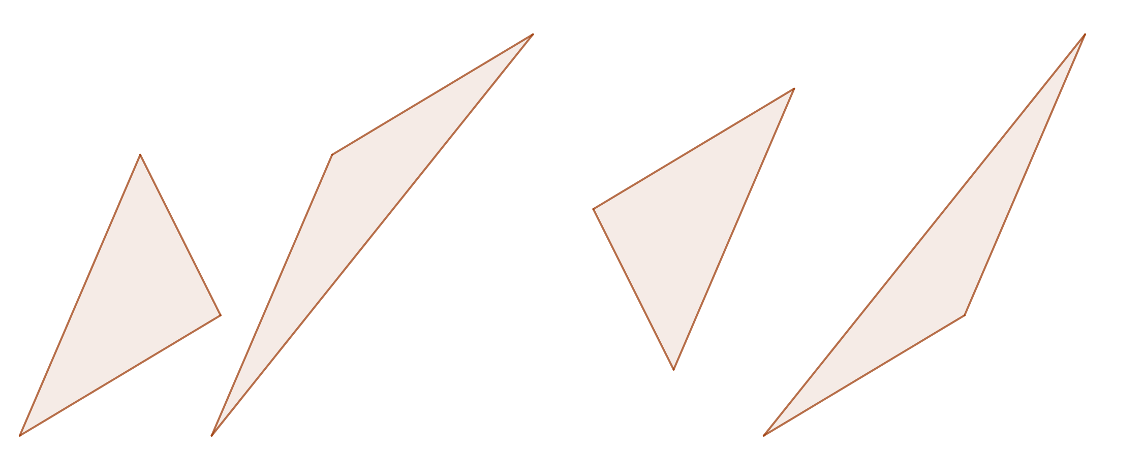
Four Triangular Areas
Notes:
sf=0.95

Slide 9
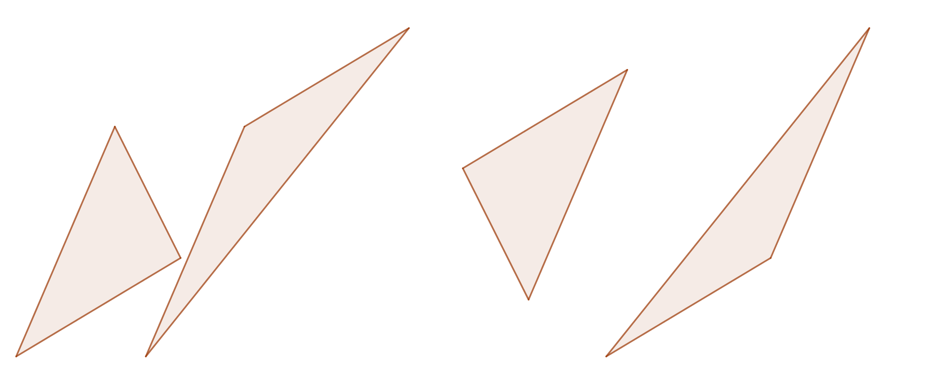
Four Triangular Areas
Notes:
sf=0.92

Slide 10
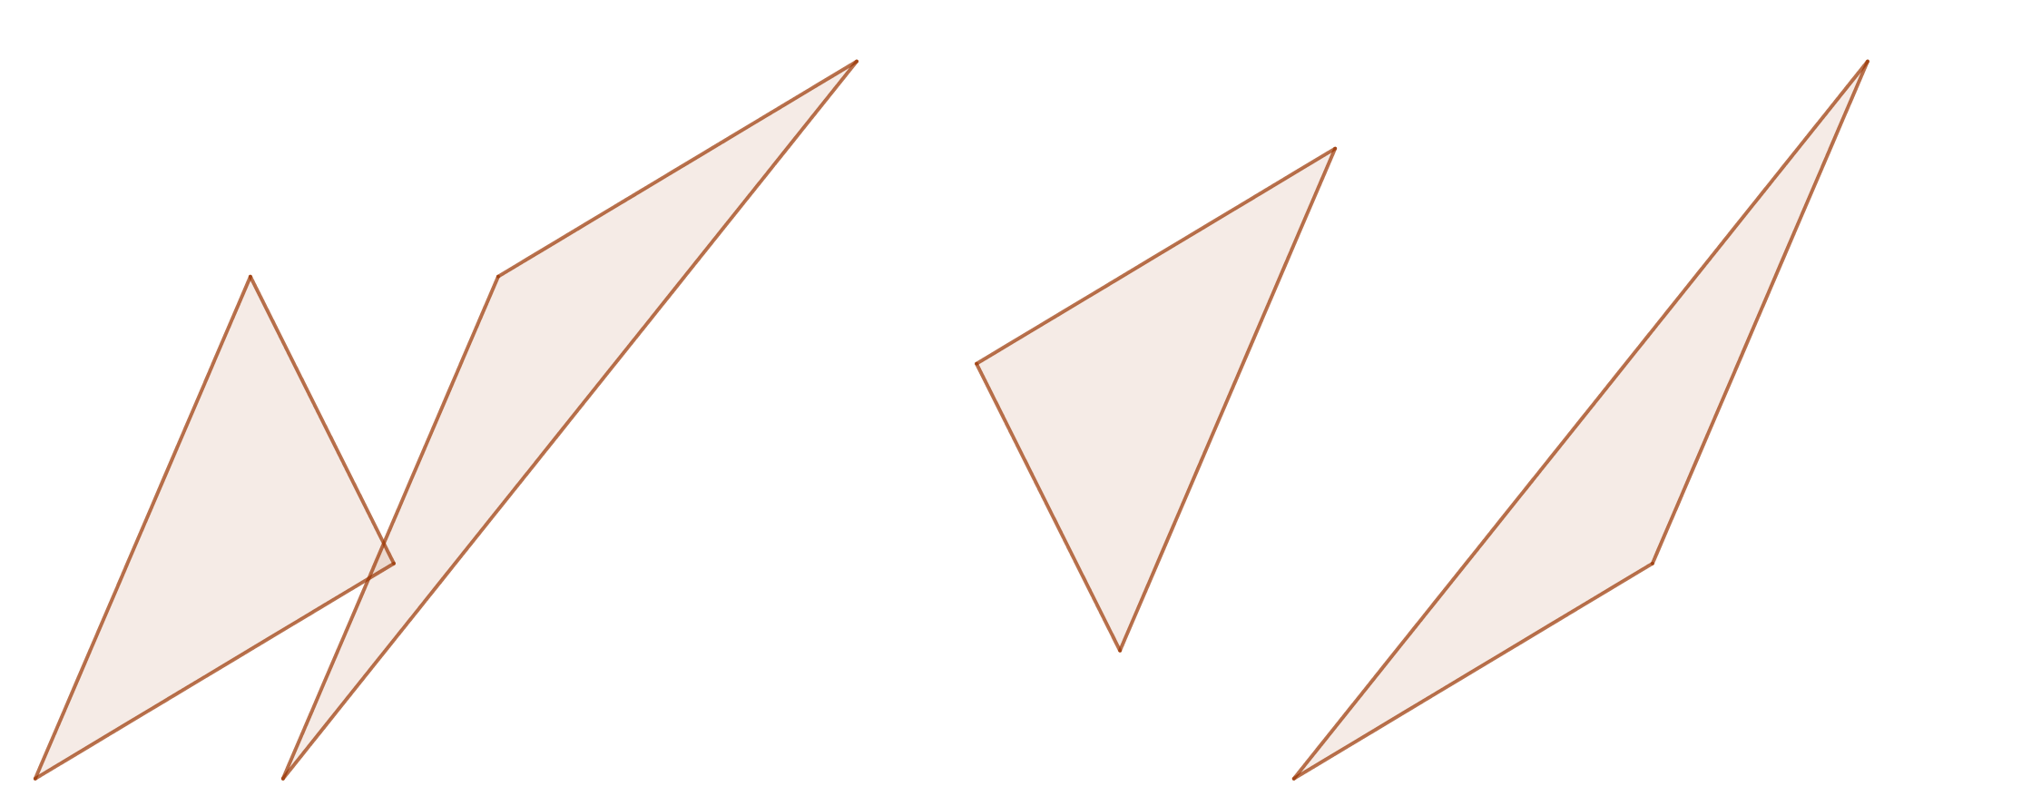
Four Triangular Areas
Notes:
sf=0.9

Slide 11
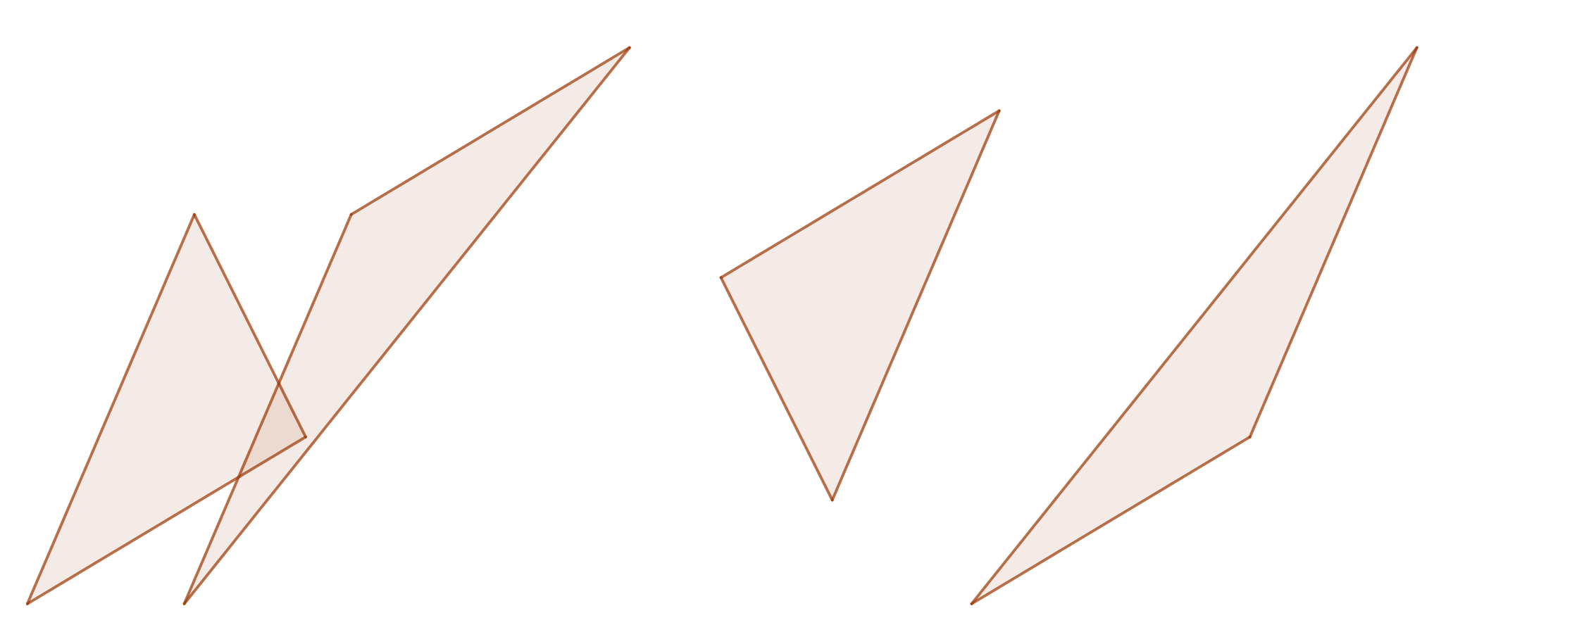
Four Triangular Areas
Notes:
sf=0.87

Slide 12
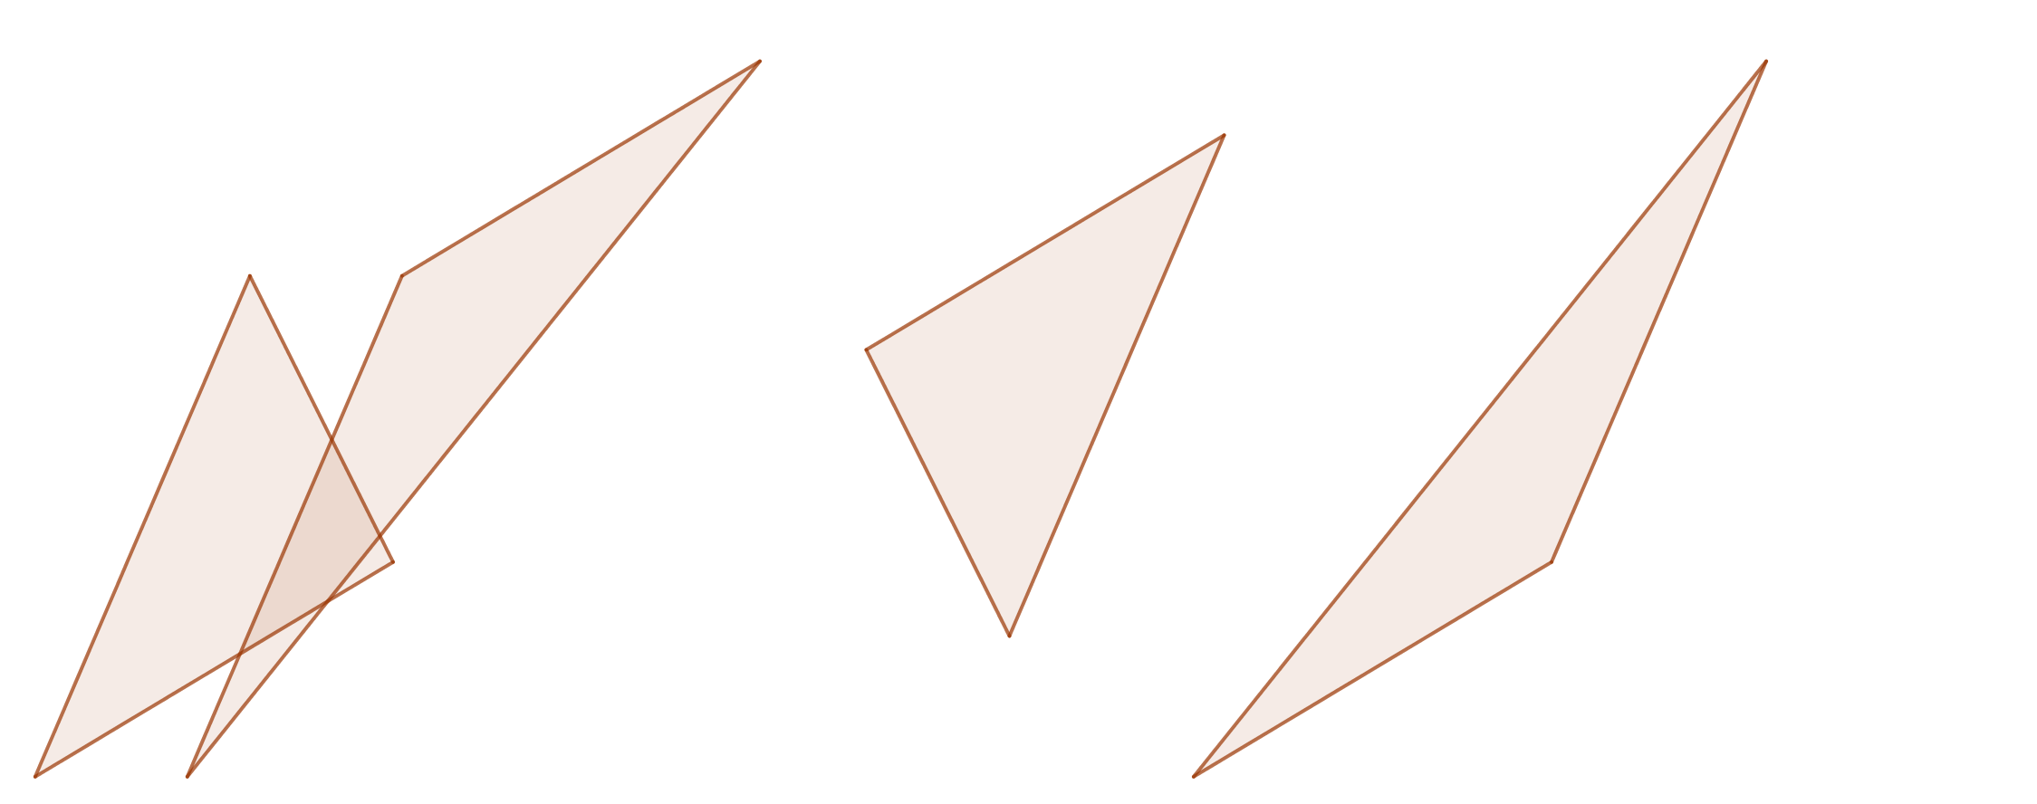
Four Triangular Areas
Notes:
sf=0.83

Slide 13
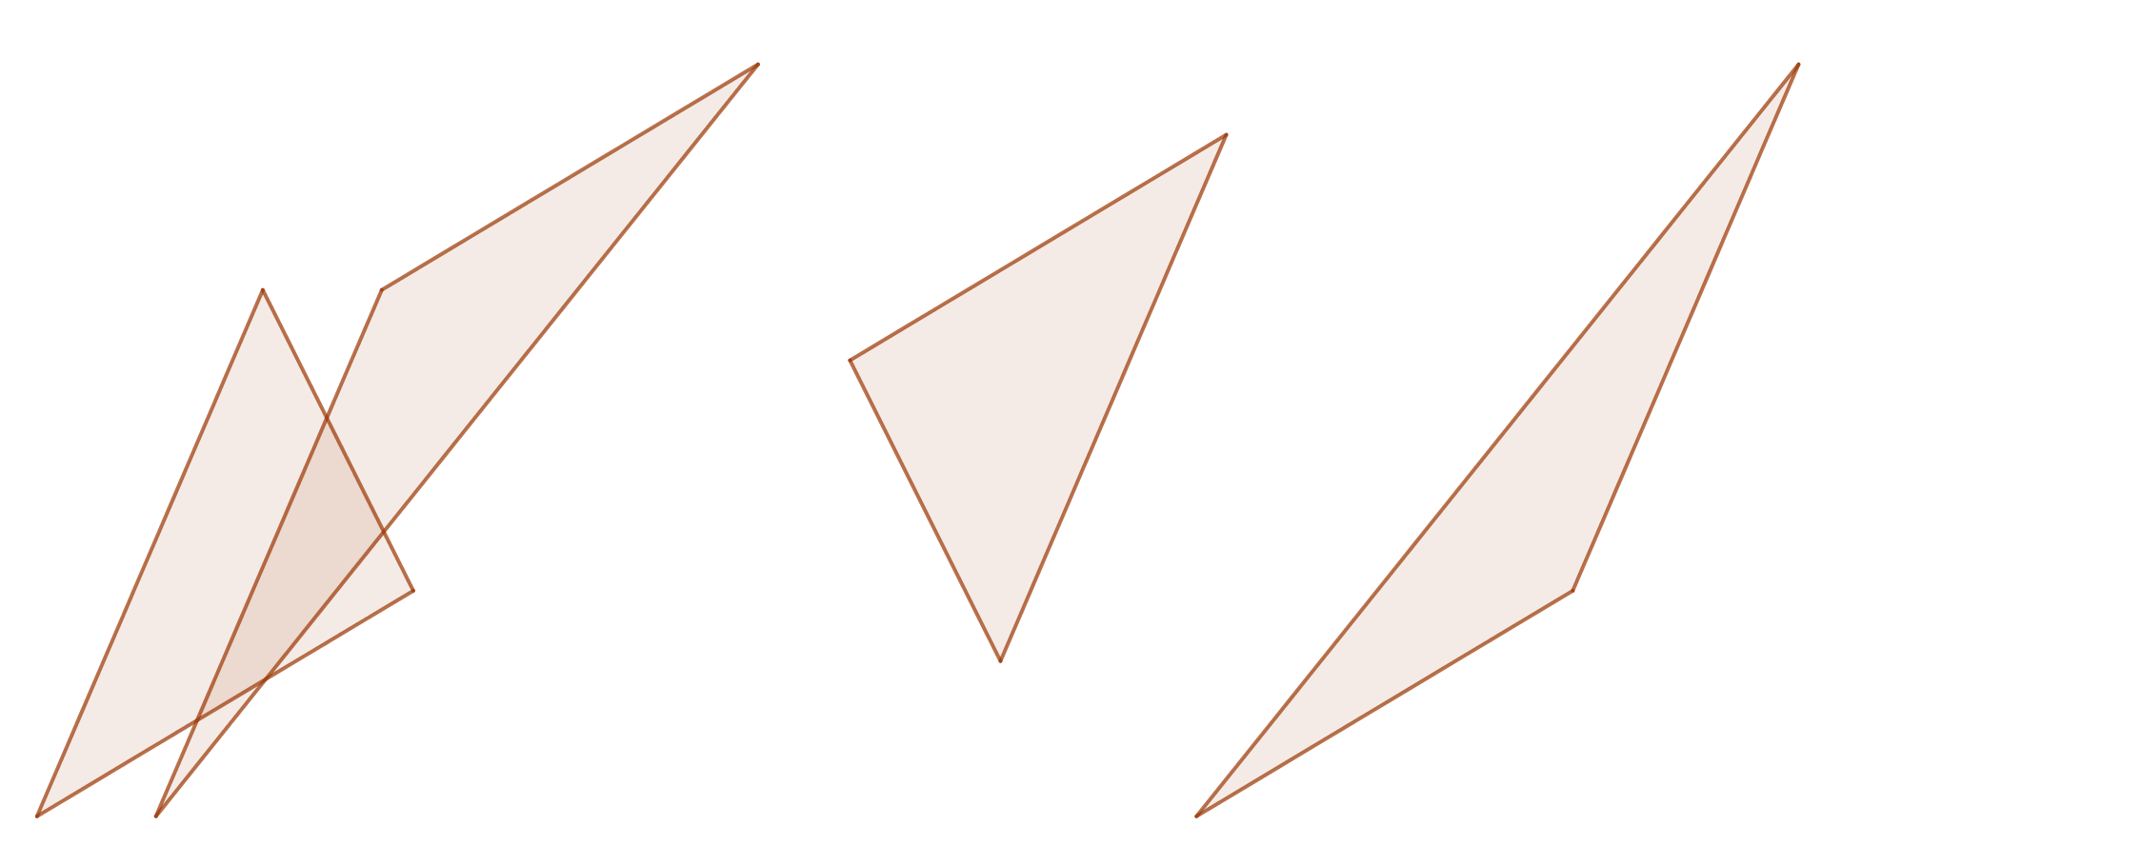
Four Triangular Areas
Notes:
sf=0.79

Slide 14
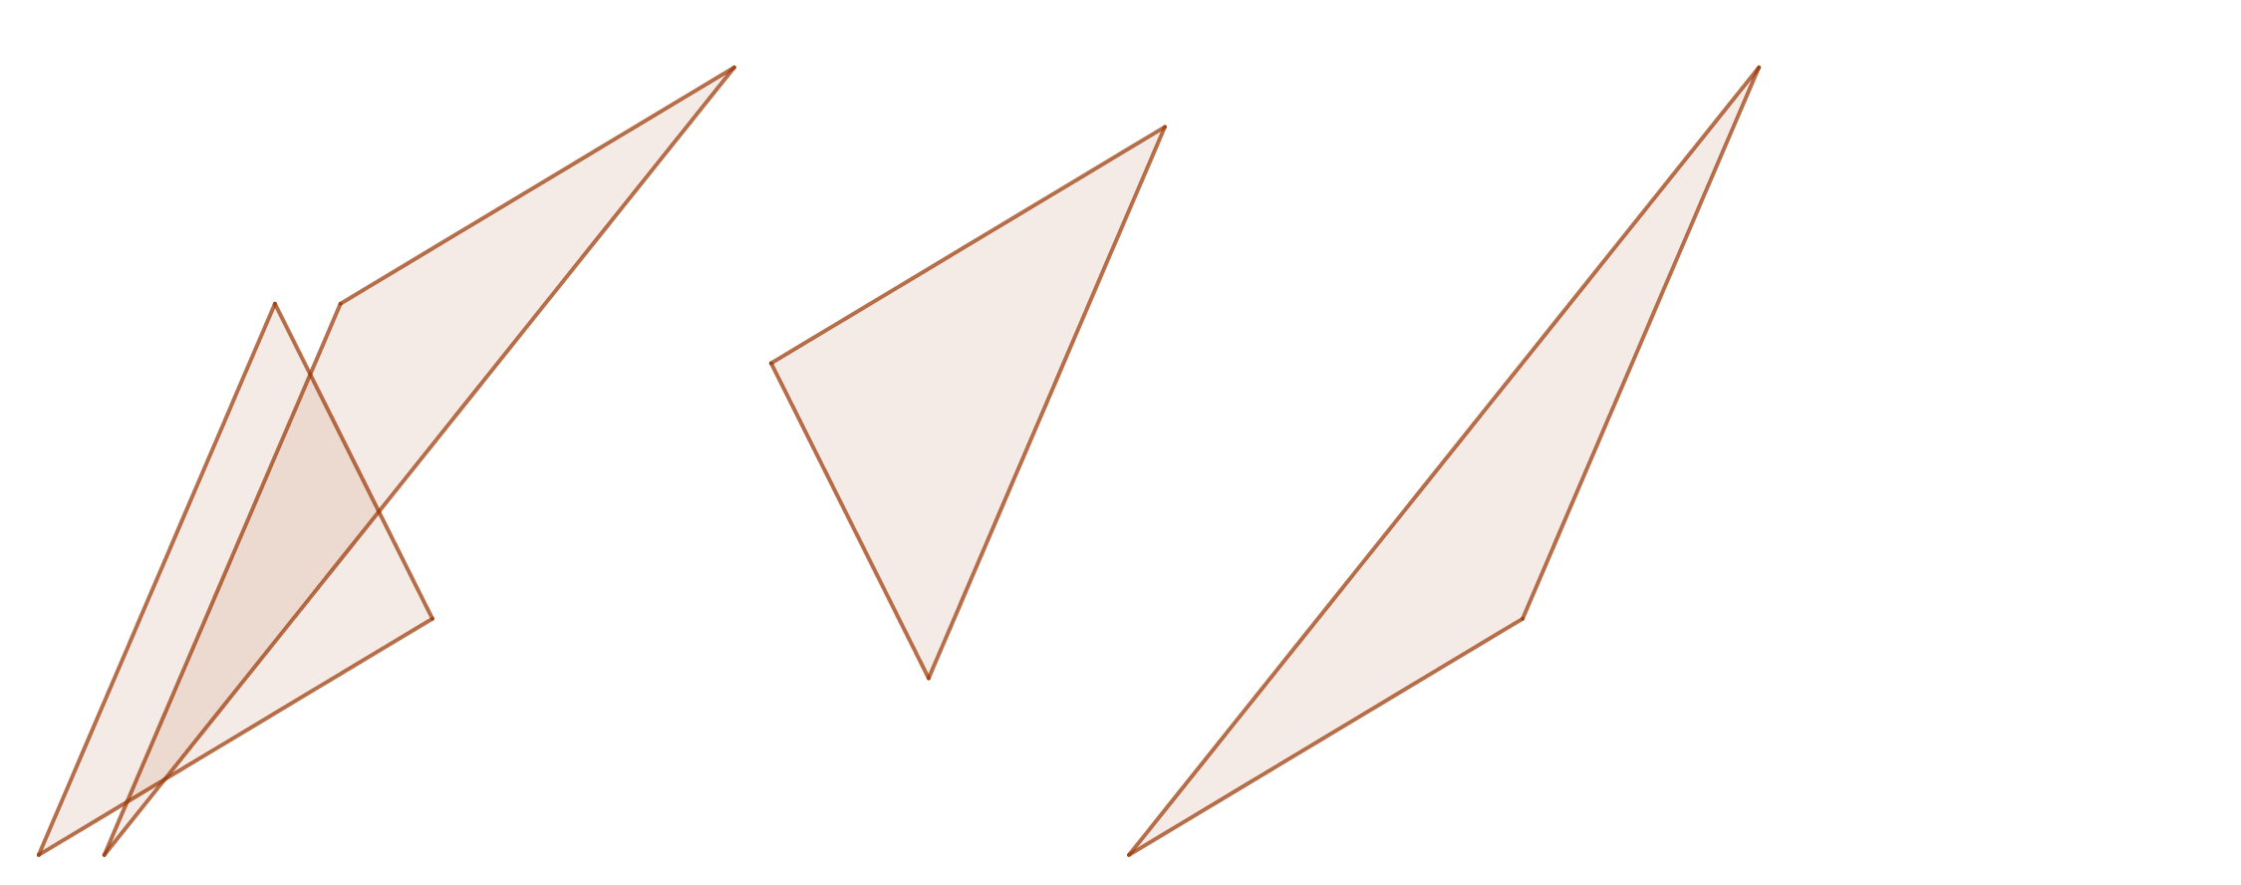
Four Triangular Areas
Notes:
sf=0.71

Slide 15
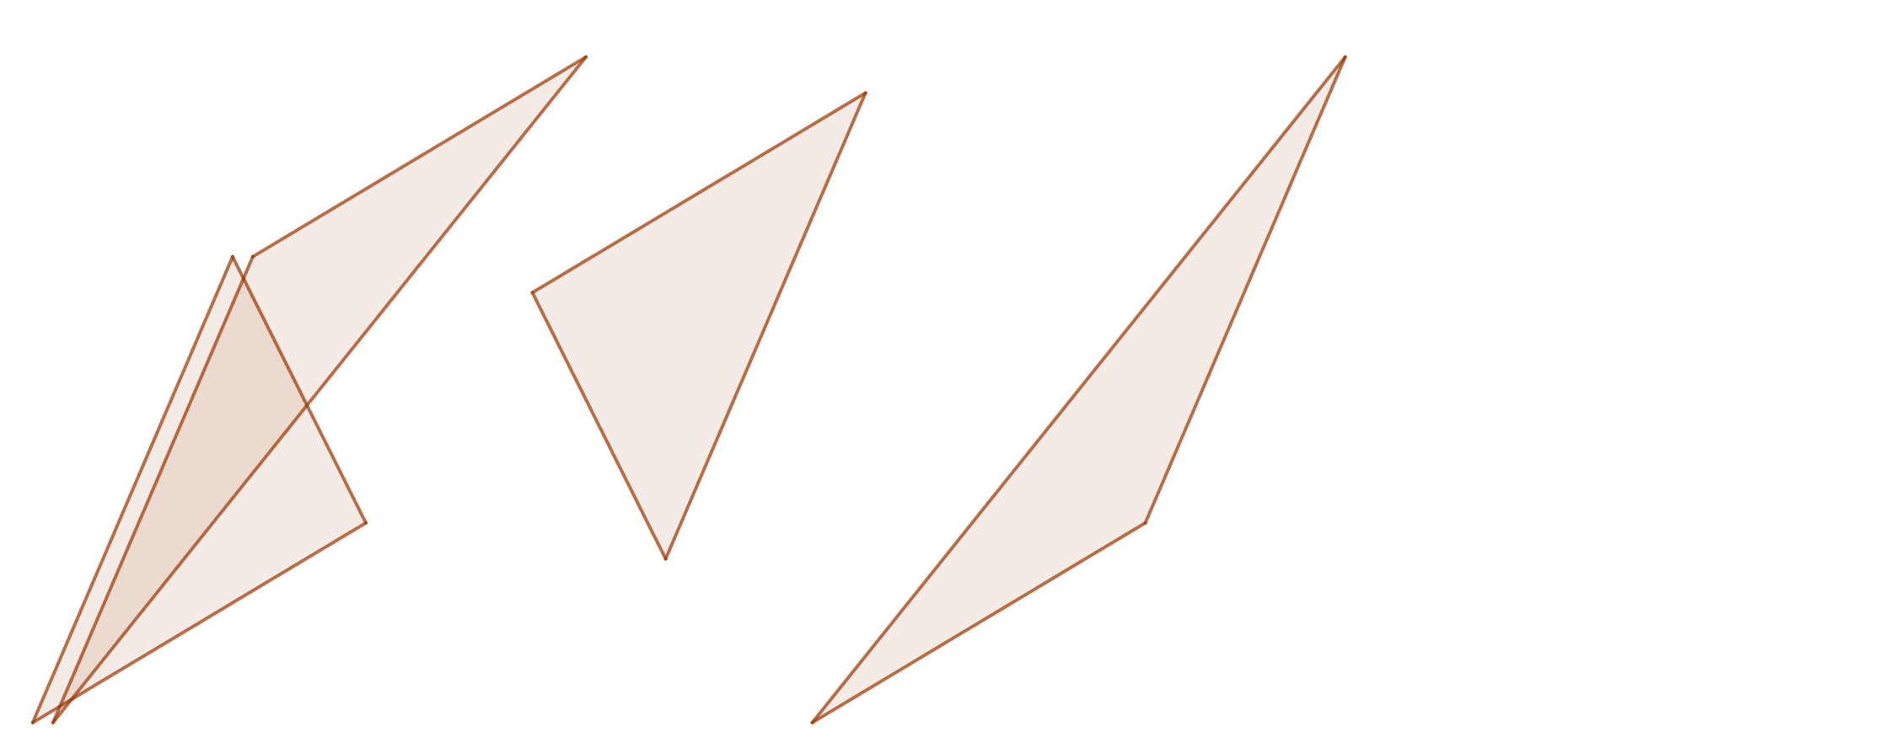
Four Triangular Areas
Notes:
sf=0.6

Slide 16
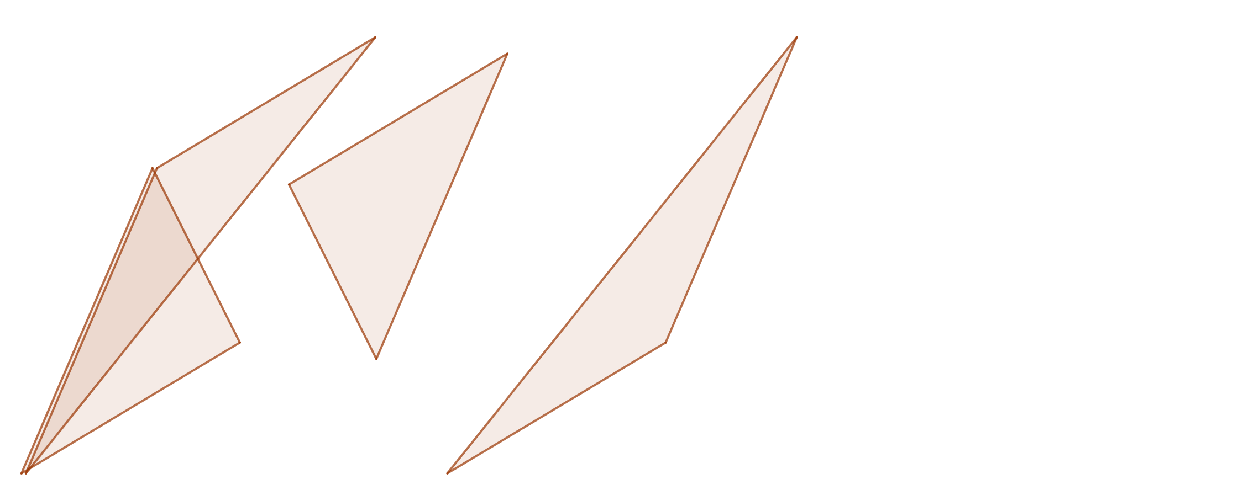
Four Triangular Areas
Notes:
sf=0.5

Slide 17
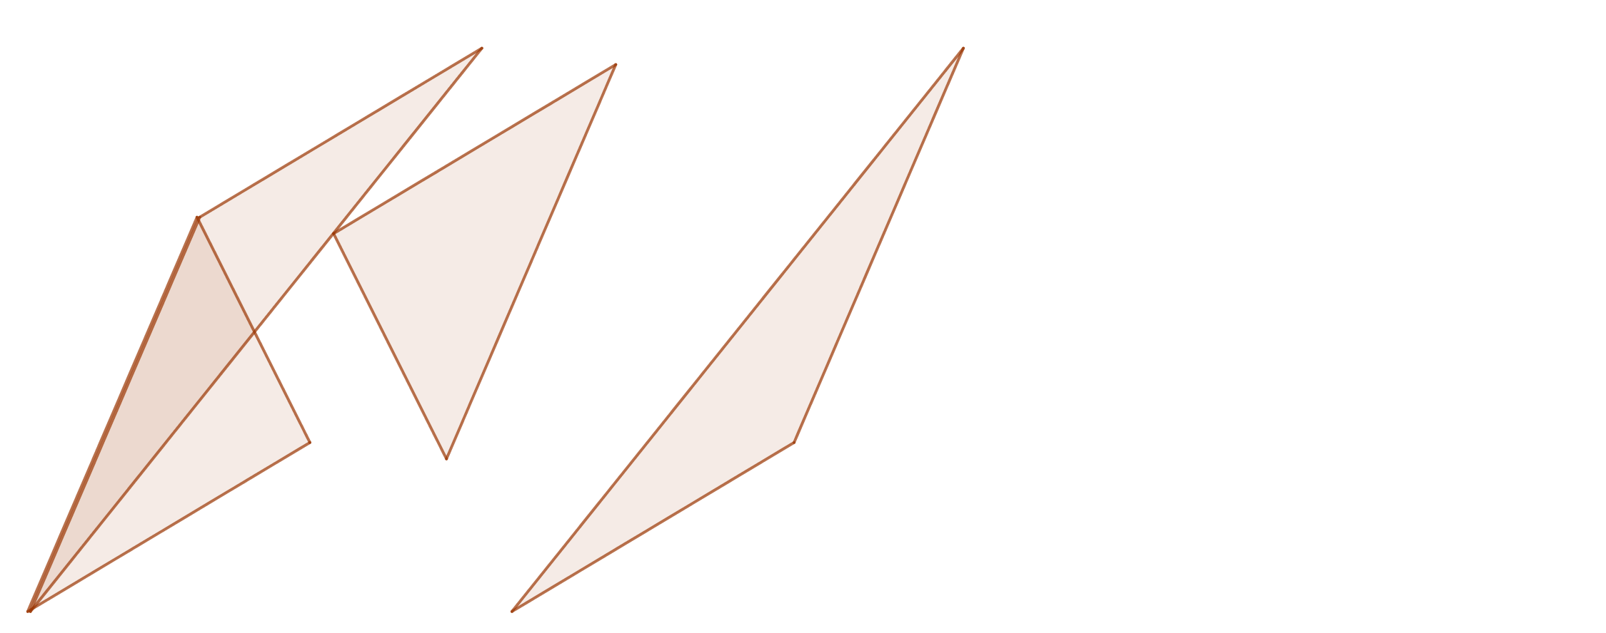
Four Triangular Areas
Notes:
sf=0.44

Slide 18
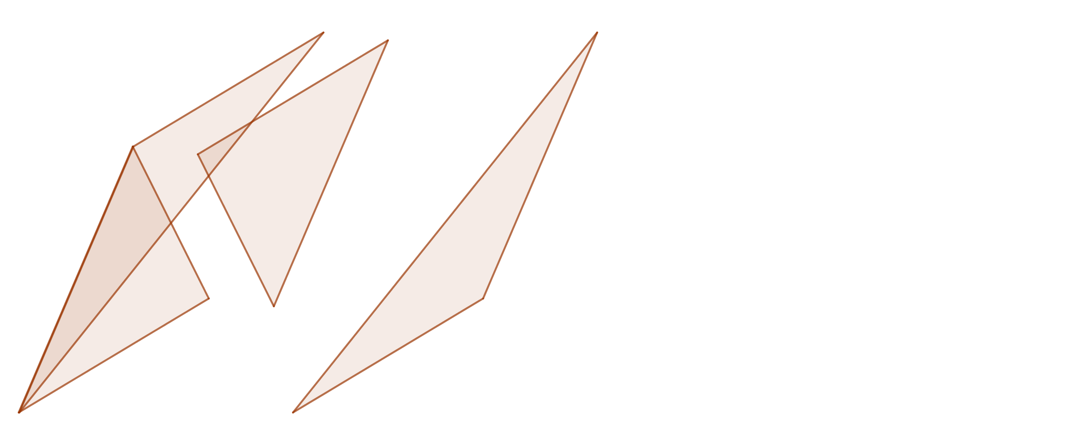
Four Triangular Areas
Notes:
sf=0.37

Slide 19
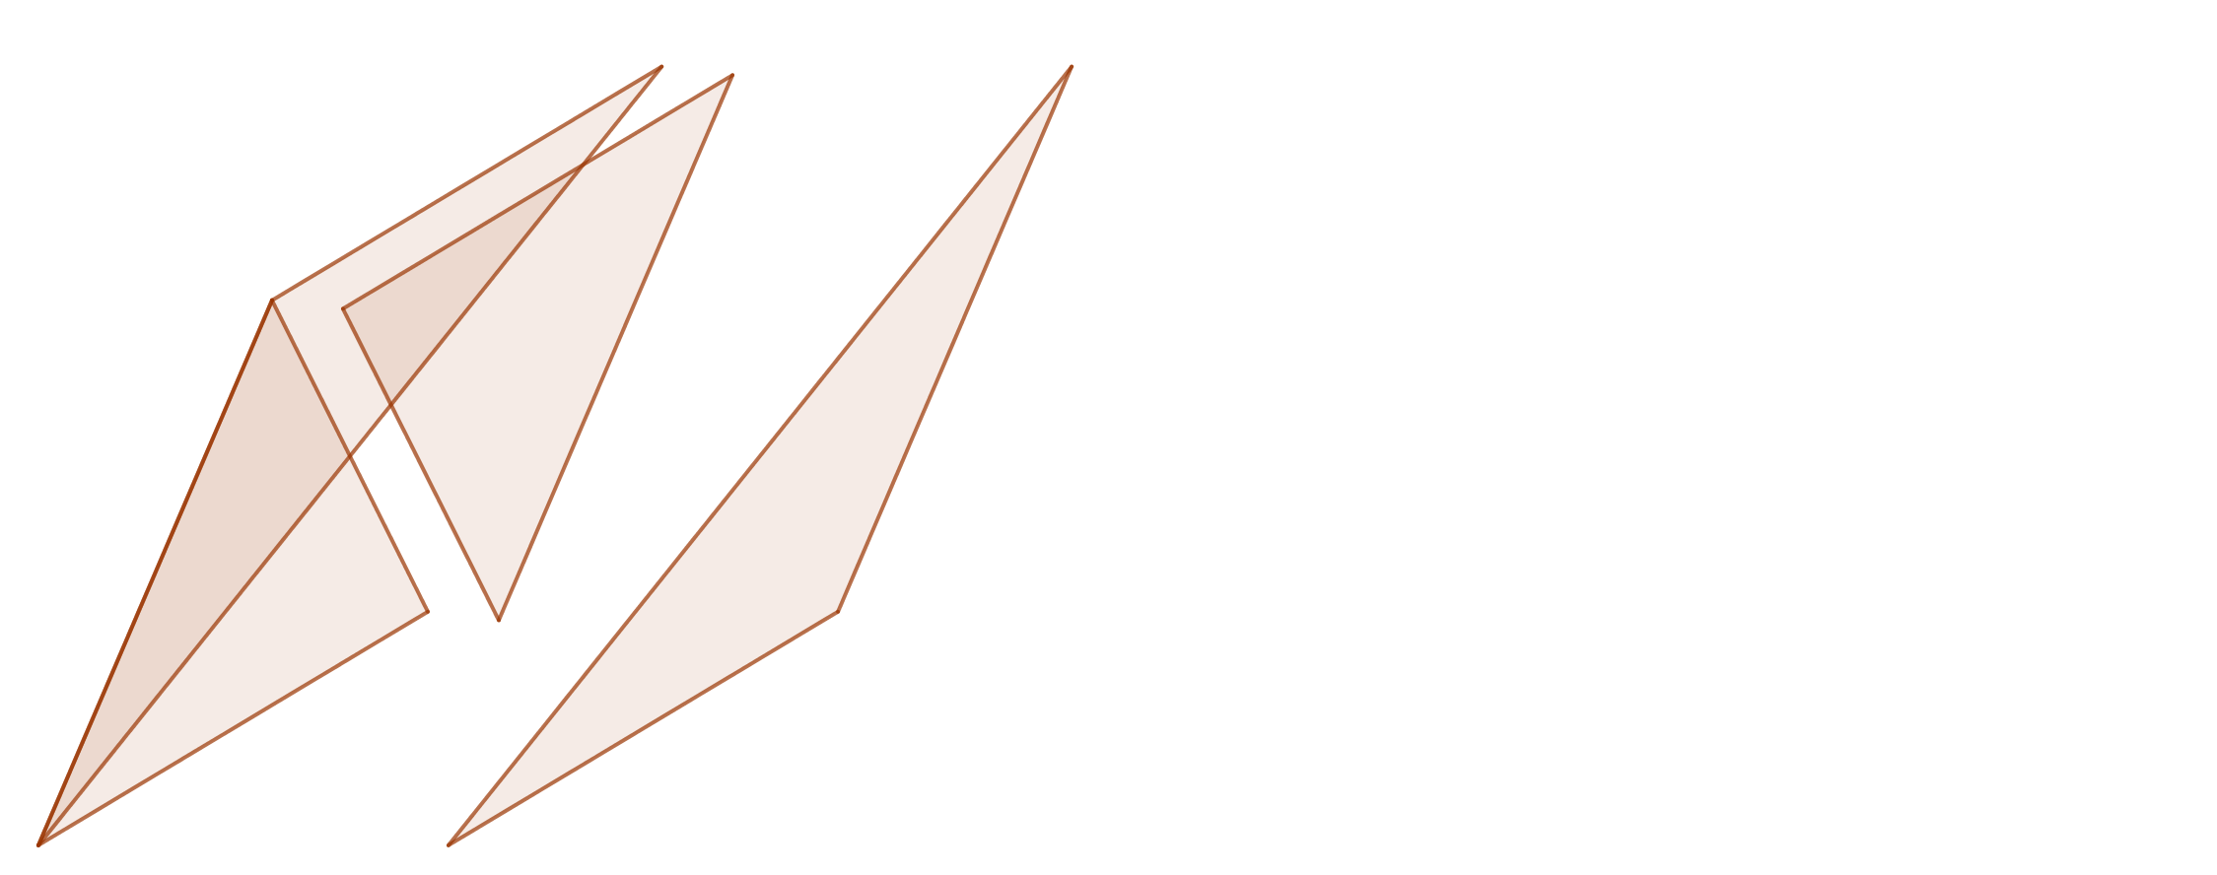
Four Triangular Areas
Notes:
sf=0.27

Slide 20
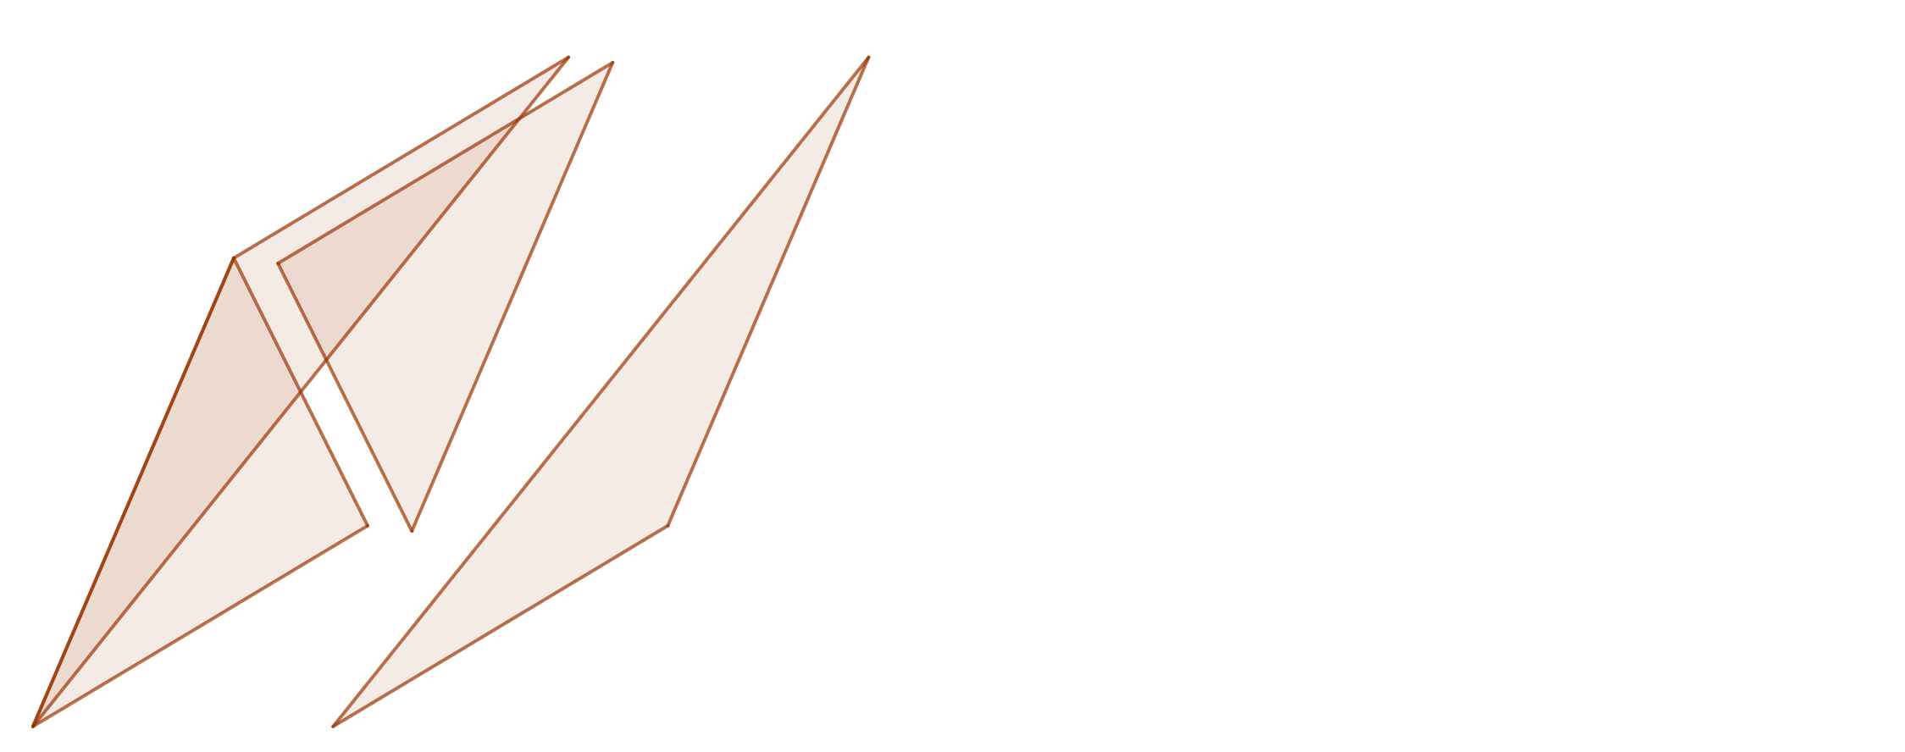
Four Triangular Areas
Notes:
sf=0.23

Slide 21
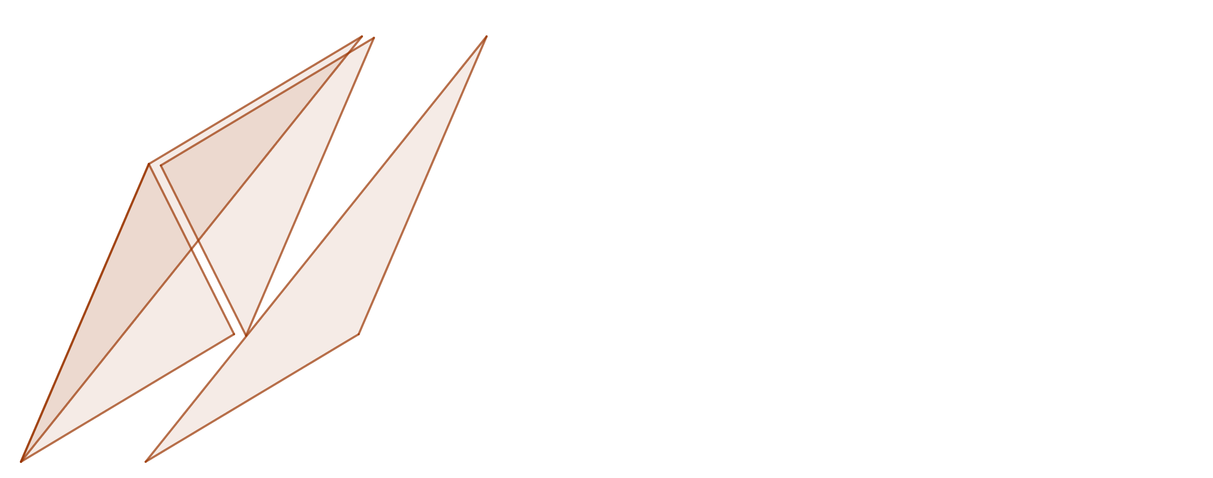
Four Triangular Areas
Notes:
sf=0.15

Slide 22
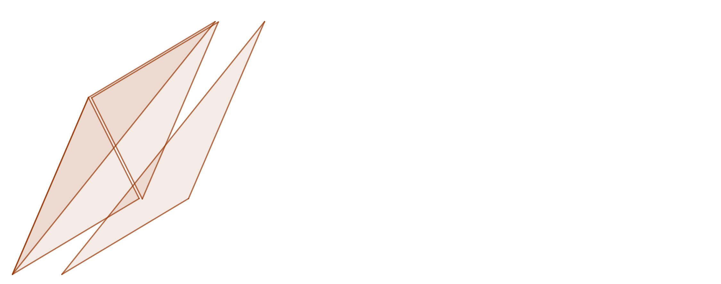
Four Triangular Areas
Notes:
sf=0.1

Slide 23
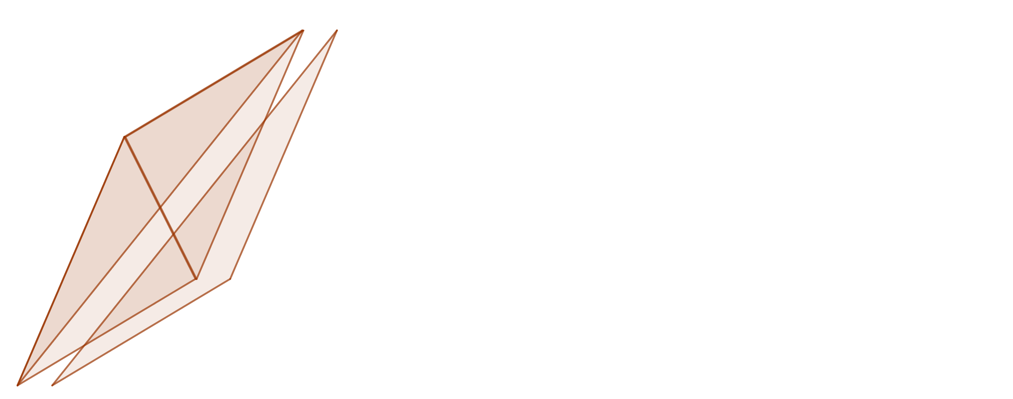
Four Triangular Areas
Notes:
sf=0.05

Slide 24
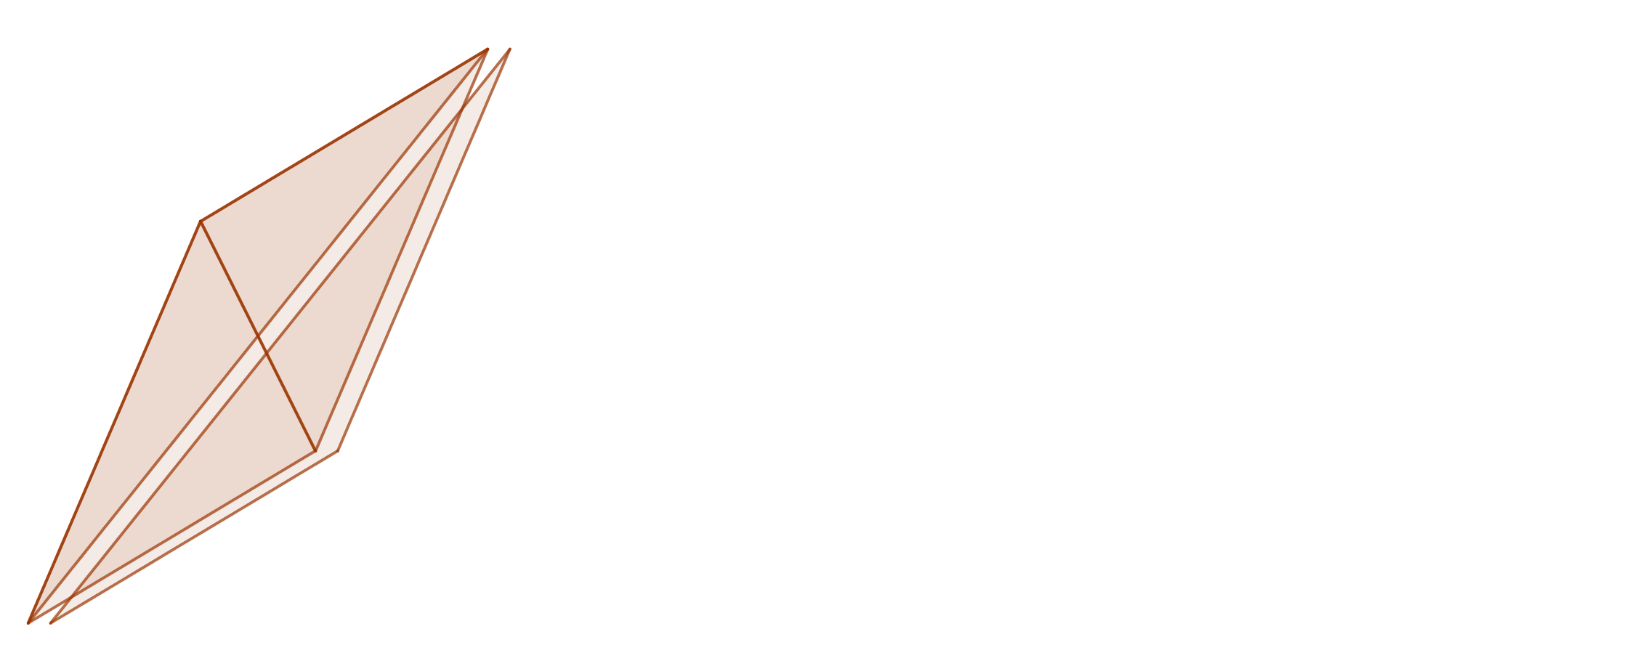
Four Triangular Areas
Notes:
sf=0.02

Slide 25
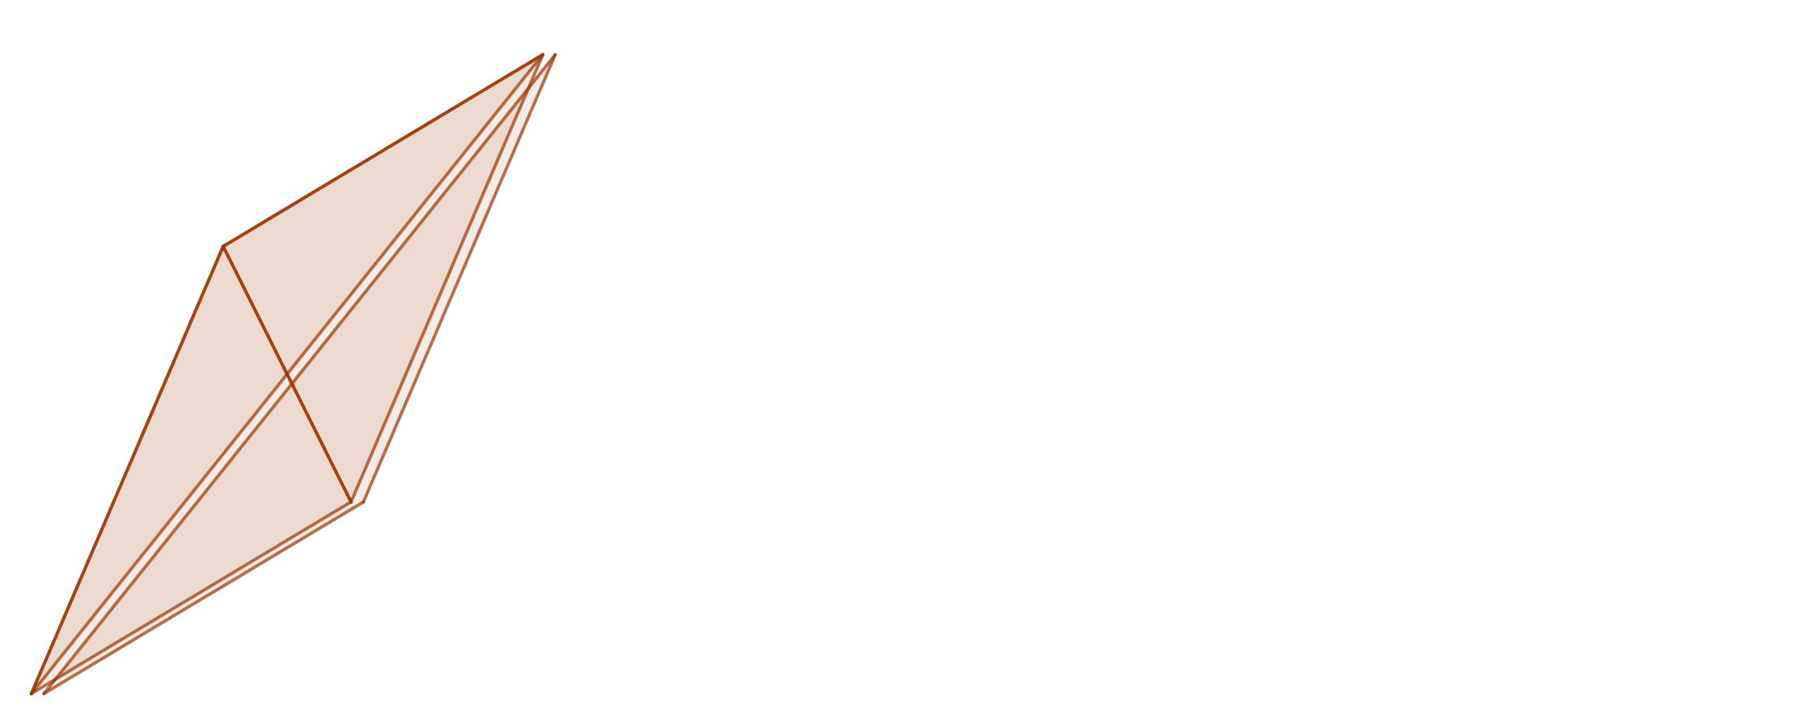
Four Triangular Areas
Notes:
sf=0.01

Slide 26
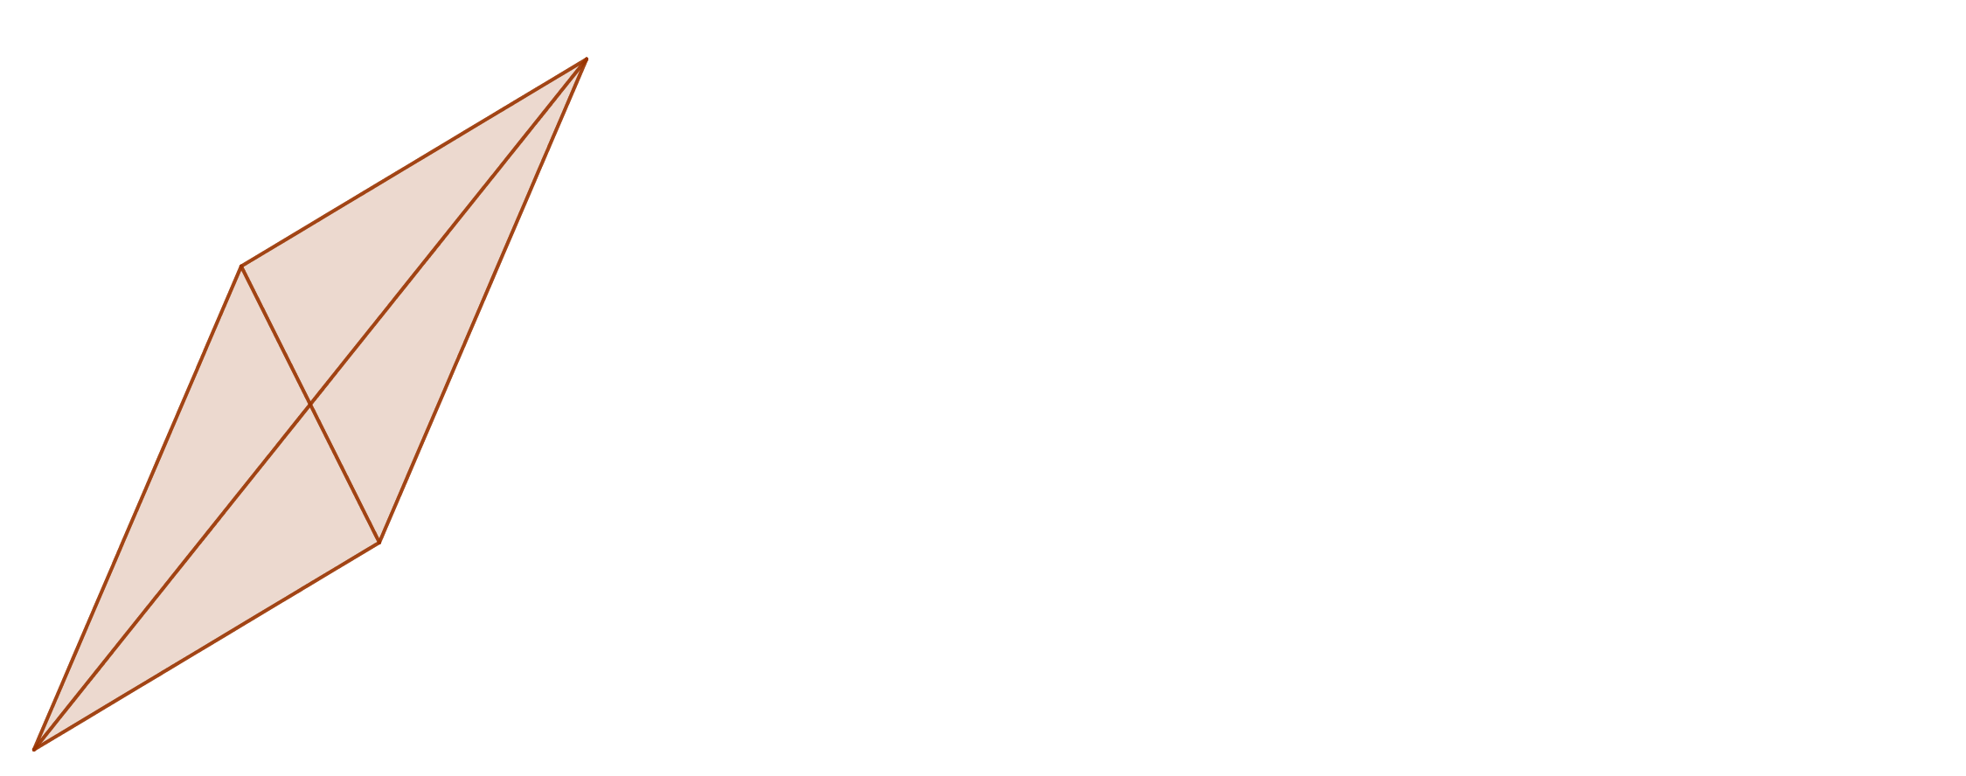
Four Triangular Areas
Notes:
sf=0.0

Slide 27
Four Triangular Areas
Each triangle came from the same parallelogram.
Each one bisected it.
So they all had the same area.
Notes:
sf=0.0

Slide 28

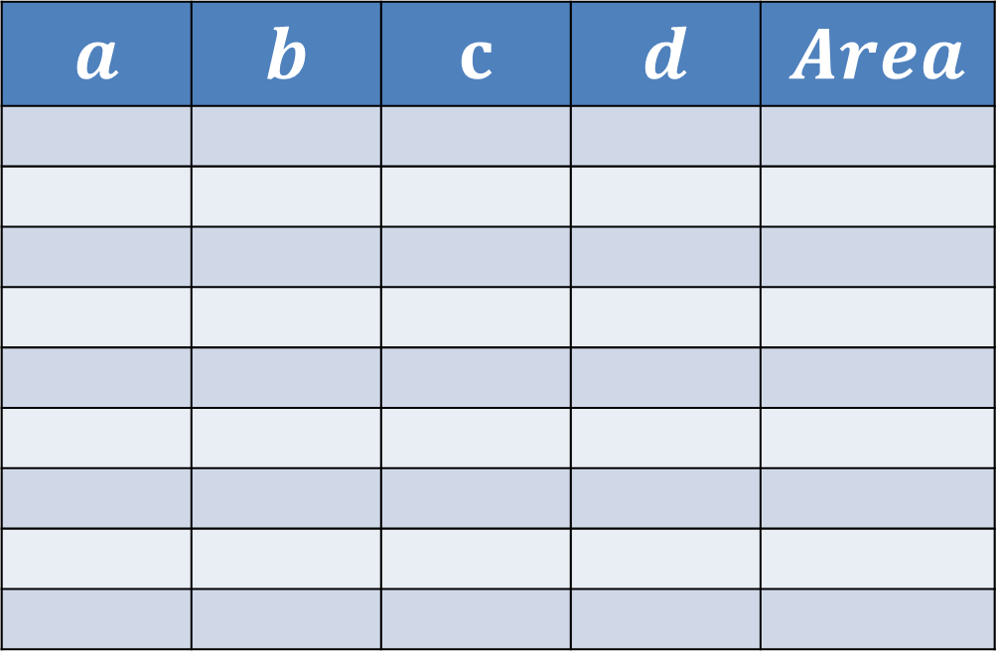



Four Triangular Areas
$$y$$
$$a$$ | $$b$$ | $$c$$ | $$d$$ | $$Area$$
$$\left(a,b\right)$$
$$\left(c,d\right)$$
$$x$$
Explore the area of triangles with one vertex at the origin.
Can you find a relationship between the area and the coordinates?

Slide 29
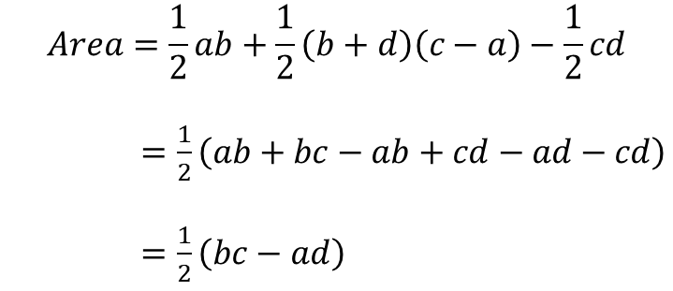

Four Triangular Areas
$$y$$
$$\left(a,b\right)$$
$$Area=\frac{1}{2}ab+\frac{1}{2}\left(b+d\right)\left(c−a\right)−\frac{1}{2}cd$$
$=\frac{1}{2}\left(ab+bc−ab+cd−ad−cd\right)$
$=\frac{1}{2}\left(bc−ad\right)$
$$\left(c,d\right)$$
$$x$$

Slide 30
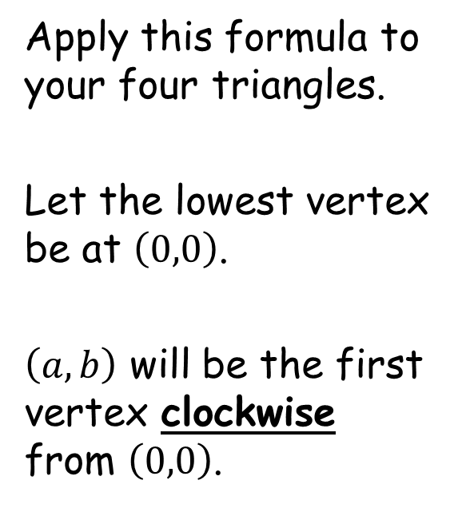

Four Triangular Areas
$$y$$
$$\left(a,b\right)$$
Apply this formula to your four triangles.
Let the lowest vertex be at $\left(0,0\right)$.
$\left(a,b\right)$ will be the first vertex clockwise from $\left(0,0\right)$.
$$Area$$
$$\frac{1}{2}\left(bc−ad\right)$$
$$\left(c,d\right)$$
$$x$$

Slide 31

















Four Triangular Areas
$$Area$$
$$\frac{1}{2}\left(bc−ad\right)$$
$$\left(8,10\right)$$
$$\left(8,10\right)$$
$$\left(3,7\right)$$
$$\left(3,7\right)$$
$$\left(3,7\right)$$
$$\left(−2,4\right)$$
$$13$$
$$13$$
$$13$$
$$\left(5,3\right)$$
$$13$$
$$\frac{1}{2}\left(4×3−\left(−2\right)×7\right)$$
$$=13$$
$$\left(5,3\right)$$
$$\left(0,0\right)$$
$$\left(0,0\right)$$
$$\left(0,0\right)$$
$$\left(0,0\right)$$
$$\frac{1}{2}\left(7×8−3×10\right)$$
$$=13$$
$$\frac{1}{2}\left(10×5−8×3\right)$$
$$=13$$
$$\frac{1}{2}\left(7×5−3×3\right)$$
$$=13$$

Slide 32
Four Triangular Areas
$$Area$$
$$\frac{1}{2}\left(bc−ad\right)$$
$$\left(8,10\right)$$
$$\left(8,10\right)$$
$$\left(3,7\right)$$
$$\left(3,7\right)$$
$$\left(3,7\right)$$
$$\left(−2,4\right)$$
$$13$$
$$13$$
$$13$$
$$\left(5,3\right)$$
$$13$$
$$\frac{1}{2}\left(4×3−\left(−2\right)×7\right)$$
$$=13$$
$$\left(5,3\right)$$
$$\left(0,0\right)$$
$$\left(0,0\right)$$
$$\left(0,0\right)$$
$$\left(0,0\right)$$
$$\frac{1}{2}\left(7×8−3×10\right)$$
$$=13$$
$$\frac{1}{2}\left(10×5−8×3\right)$$
$$=13$$
$$\frac{1}{2}\left(7×5−3×3\right)$$
$$=13$$
It doesn’t actually matter which vertex is at the origin…

Slide 33








Four Triangular Areas
$$Area$$
$$\frac{1}{2}\left(bc−ad\right)$$
$$\left(8,10\right)$$
$$\left(8,10\right)$$
$$\left(5,3\right)$$
$$\left(0,0\right)$$
$$\left(3,7\right)$$
$$13$$
$$\left(0,0\right)$$
$$13$$
$$13$$
$$\left(2,−4\right)$$
$$13$$
$$\left(5,3\right)$$
$$\left(2,−4\right)$$
$$\left(−3,−7\right)$$
$$\left(0,0\right)$$
$$\left(0,0\right)$$
$$\frac{1}{2}\left(7×8−3×10\right)$$
$$=13$$
$$\frac{1}{2}\left(3×2−5×−4\right)=13$$
$$\frac{1}{2}\left(10×5−8×3\right)$$
$$=13$$
$$\frac{1}{2}\left(−4×−3−2×−7\right)=13$$
It doesn’t actually matter which vertex is at the origin…

Slide 35
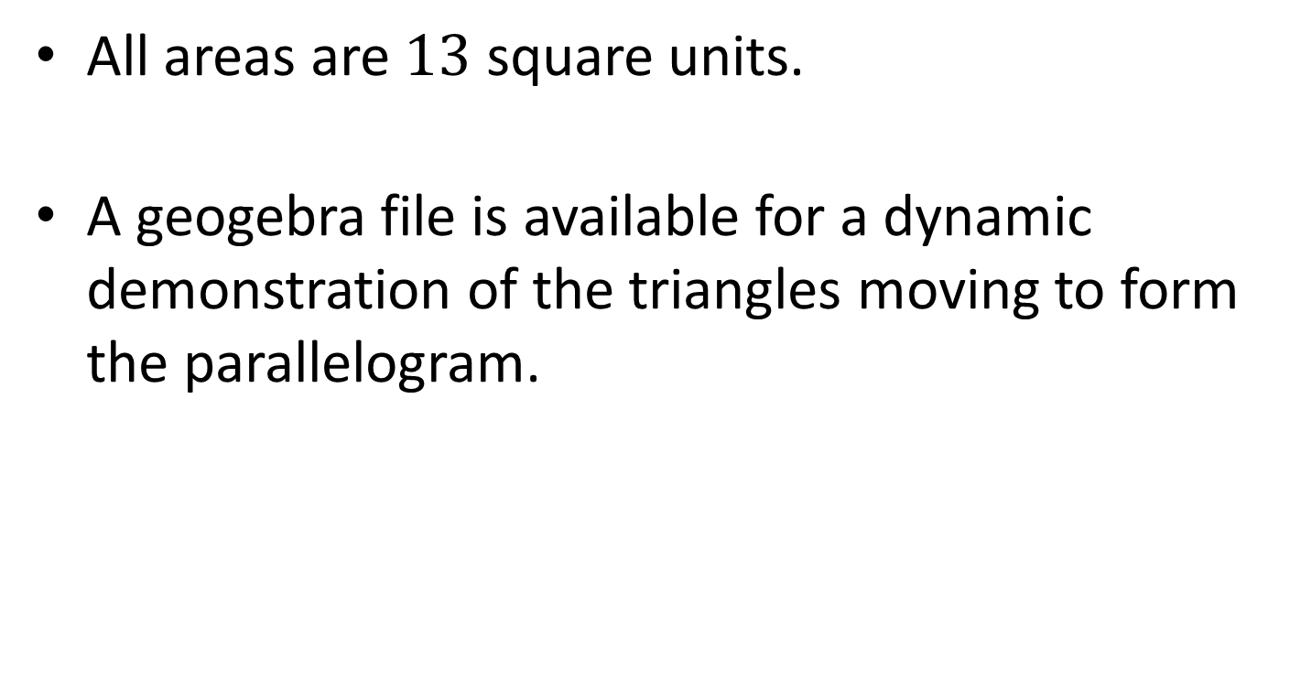
NOTE TO TEACHER
All areas are $13$ square units.
A geogebra file is available for a dynamic demonstration of the triangles moving to form the parallelogram.

Slide 36
Resources

Slide 37
SIC_77
Four Triangular Areas
$$\left(7,13\right)$$
$$\left(10,11\right)$$
$$\left(8,10\right)$$
$$\left(4,9\right)$$
$$\left(2,10\right)$$
$$\left(3,7\right)$$
$$\left(6,5\right)$$
$$\left(7,4\right)$$
$$\left(5,3\right)$$
$$\left(1,2\right)$$
$$\left(−1,3\right)$$
$$\left(2,1\right)$$
A
Calculate the area of each of the four triangles.
The coordinates of each vertex are shown.

Slide 38












SIC_77
Four Triangular Areas
$$\left(6,13\right)$$
$$\left(8,11\right)$$
$$\left(9,10\right)$$
$$\left(5,9\right)$$
$$\left(1,10\right)$$
$$\left(4,7\right)$$
$$\left(7,5\right)$$
$$\left(5,4\right)$$
$$\left(6,3\right)$$
$$\left(2,2\right)$$
$$\left(−2,3\right)$$
$$\left(0,1\right)$$
B
Calculate the area of each of the four triangles.
The coordinates of each vertex are shown.

Slide 39












SIC_77
Four Triangular Areas
$$\left(8,13\right)$$
$$\left(7,12\right)$$
$$\left(7,10\right)$$
$$\left(5,10\right)$$
$$\left(3,10\right)$$
$$\left(2,7\right)$$
$$\left(7,6\right)$$
$$\left(4,5\right)$$
$$\left(4,3\right)$$
$$\left(2,3\right)$$
$$\left(0,3\right)$$
$$\left(−1,2\right)$$
C
Calculate the area of each of the four triangles.
The coordinates of each vertex are shown.

Slide 40












SIC_77
Four Triangular Areas
$$\left(12,16\right)$$
$$\left(9,11\right)$$
$$\left(4,10\right)$$
$$\left(2,11\right)$$
$$\left(7,13\right)$$
$$\left(−1,7\right)$$
$$\left(4,7\right)$$
$$\left(6,4\right)$$
$$\left(1,3\right)$$
$$\left(−1,4\right)$$
$$\left(4,6\right)$$
$$\left(1,1\right)$$
D
Calculate the area of each of the four triangles.
The coordinates of each vertex are shown.

Slide 41












SIC_77
Four Triangular Areas
$$\left(12,15\right)$$
$$\left(11,11\right)$$
$$\left(4,12\right)$$
$$\left(6,11\right)$$
$$\left(7,12\right)$$
$$\left(−1,9\right)$$
$$\left(8,7\right)$$
$$\left(8,4\right)$$
$$\left(1,5\right)$$
$$\left(3,4\right)$$
$$\left(4,5\right)$$
$$\left(3,1\right)$$
E
Calculate the area of each of the four triangles.
The coordinates of each vertex are shown.

Slide 42












SIC_77
Four Triangular Areas
$$\left(4,15\right)$$
$$\left(11,9\right)$$
$$\left(5,12\right)$$
$$\left(9,12\right)$$
$$\left(−1,12\right)$$
$$\left(0,9\right)$$
$$\left(11,8\right)$$
$$\left(8,2\right)$$
$$\left(2,5\right)$$
$$\left(6,5\right)$$
$$\left(−4,5\right)$$
$$\left(3,−1\right)$$
F
Calculate the area of each of the four triangles.
The coordinates of each vertex are shown.

Slide 43












SIC_77
Four Triangular Areas
$$\left(5,17\right)$$
$$\left(14,11\right)$$
$$\left(10,12\right)$$
$$\left(7,6\right)$$
$$\left(0,14\right)$$
$$\left(5,9\right)$$
$$\left(9,2\right)$$
$$\left(11,4\right)$$
$$\left(7,5\right)$$
$$\left(4,−1\right)$$
$$\left(−3,7\right)$$
$$\left(6,1\right)$$
G
Calculate the area of each of the four triangles.
The coordinates of each vertex are shown.

Slide 44












SIC_77
Four Triangular Areas
$$\left(6,14\right)$$
$$\left(14,14\right)$$
$$\left(10,11\right)$$
$$\left(8,6\right)$$
$$\left(1,11\right)$$
$$\left(5,8\right)$$
$$\left(10,2\right)$$
$$\left(11,7\right)$$
$$\left(7,4\right)$$
$$\left(5,−1\right)$$
$$\left(−2,4\right)$$
$$\left(6,4\right)$$
H
Calculate the area of each of the four triangles.
The coordinates of each vertex are shown.

Slide 45












SIC_77
Four Triangular Areas
$$\left(13,14\right)$$
$$\left(14,12\right)$$
$$\left(6,10\right)$$
$$\left(11,6\right)$$
$$\left(8,11\right)$$
$$\left(1,7\right)$$
$$\left(13,2\right)$$
$$\left(11,5\right)$$
$$\left(3,3\right)$$
$$\left(8,−1\right)$$
$$\left(5,4\right)$$
$$\left(6,2\right)$$
I
Calculate the area of each of the four triangles.
The coordinates of each vertex are shown.

Slide 46












SIC_77
Four Triangular Areas
$$\left(10,14\right)$$
$$\left(12,13\right)$$
$$\left(0,10\right)$$
$$\left(10,7\right)$$
$$\left(5,11\right)$$
$$\left(−5,7\right)$$
$$\left(12,3\right)$$
$$\left(9,6\right)$$
$$\left(−3,3\right)$$
$$\left(7,0\right)$$
$$\left(2,4\right)$$
$$\left(4,3\right)$$
J
Calculate the area of each of the four triangles.
The coordinates of each vertex are shown.

Slide 47












SIC_77
Four Triangular Areas
$$\left(14,12\right)$$
$$\left(10,9\right)$$
$$\left(1,13\right)$$
$$\left(1,3\right)$$
$$\left(9,9\right)$$
$$\left(−4,10\right)$$
$$\left(3,−1\right)$$
$$\left(7,2\right)$$
$$\left(−2,6\right)$$
$$\left(−2,−4\right)$$
$$\left(6,2\right)$$
$$\left(2,−1\right)$$
K
Calculate the area of each of the four triangles.
The coordinates of each vertex are shown.

Slide 48









SIC_77
Four Triangular Areas
$$\left(7,13\right)$$
$$\left(15,7\right)$$
$$\left(7,5\right)$$
$$\left(0,8\right)$$
$$\left(2,10\right)$$
$$\left(2,2\right)$$
$$\left(2,4\right)$$
$$\left(12,0\right)$$
$$\left(4,−2\right)$$
$$\left(−3,1\right)$$
$$\left(−1,3\right)$$
$$\left(7,−3\right)$$
L
Calculate the area of each of the four triangles.
The coordinates of each vertex are shown.

Slide 49
SIC_77
Four Triangular Areas
$$y$$
$$\left(a,b\right)$$
Investigation
$$\left(c,d\right)$$
$$x$$
Explore the area of triangles with one vertex at the origin.
Can you find a relationship between the area and the coordinates?

Slide 50
SIC_77
Four Triangular Areas
$$y$$
$$\left(a,b\right)$$
Investigation
$$\left(c,d\right)$$
$$x$$
Explore the area of triangles with one vertex at the origin.
Can you find a relationship between the area and the coordinates?

Slide 51
SIC_77
Four Triangular Areas
$$y$$
$$\left(a,b\right)$$
Investigation
$$\left(c,d\right)$$
$$x$$
Explore the area of triangles with one vertex at the origin.
Can you find a relationship between the area and the coordinates?

Slide 52
SIC_77
Four Triangular Areas
$$y$$
$$\left(a,b\right)$$
Investigation
$$\left(c,d\right)$$
$$x$$
Explore the area of triangles with one vertex at the origin.
Can you find a relationship between the area and the coordinates?

